Slide 1

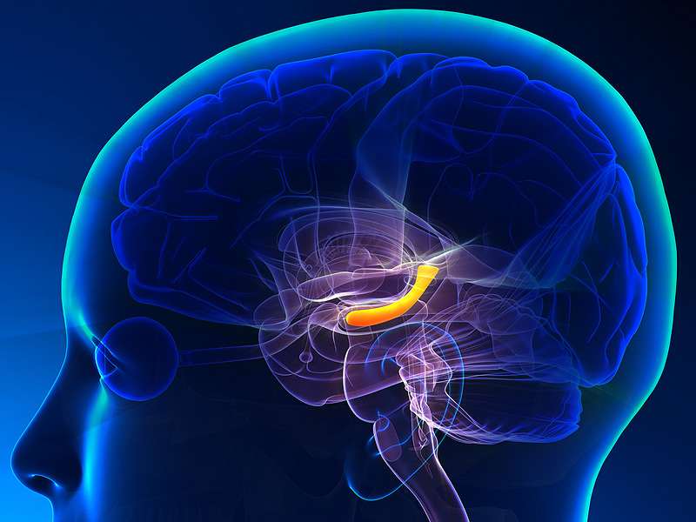
The hippocampus as a predictive map
Kimberly L Stachenfeld, Matthew M Botvinick & Samuel J Gershman
Qiang Lee
Institute of Biophysics， Chinese Academy of Sciences
Nove 11, 2017

Slide 2

Background

Slide 3




The Nobel Prize in Physiology or Medicine 2014
John O'Keefe
Born: 18 November 1939, New York, NY, USA
May-Britt Moser
Born: 4 January 1963, Fosnavåg, Norway
Edvard I. Moser
Born: 27 April 1962, Ålesund, Norway
for their discoveries of cells that constitute a positioning system in the brain

Slide 4
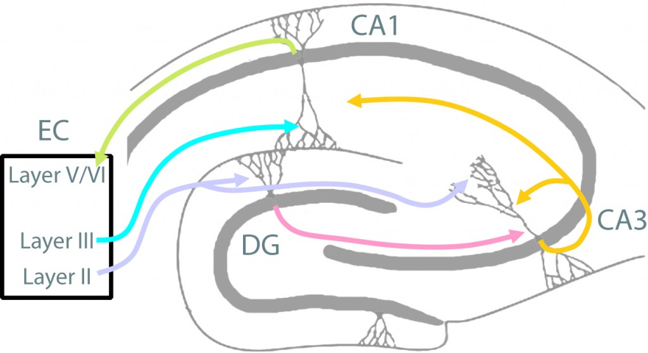
The Circuits of Hippocampus and entorhinal cortex in memory and learning
EC-Entorhinal Cortex DG-Dentate Gyrus
Reproduced from Neuro Circuits and Memoey Lab
http://neural circuits.uwm.edu/neural-circuits-of-the-hippocampus/

Slide 5
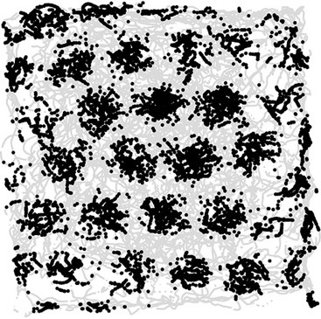
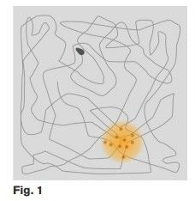
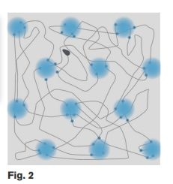
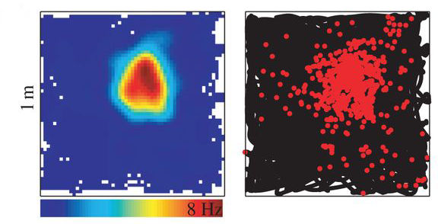
Grid Cell and Place Cell
Reproduced from Internet.

Slide 6
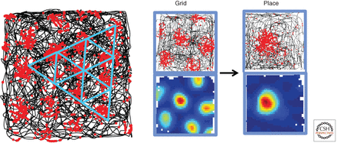
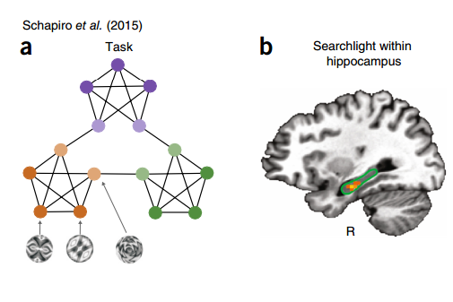
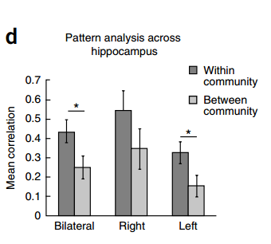
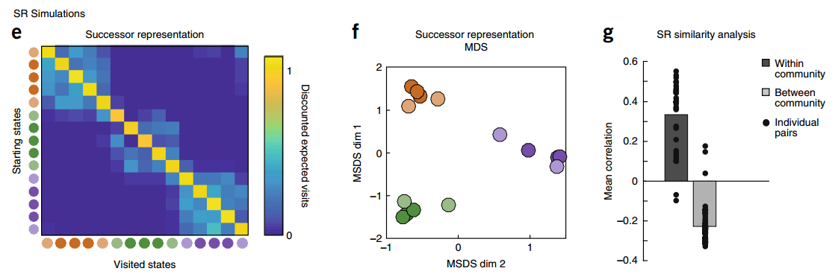
Reproduced from Kimberly L Stachenfeld et al. (2017) Nature Neuroscience.

Slide 7
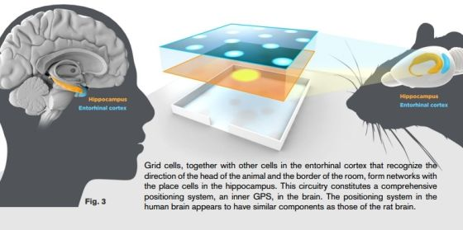
Human and Rat
Reproduced from Internet

Slide 8
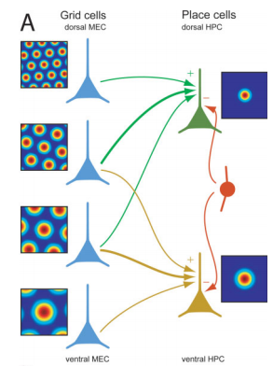
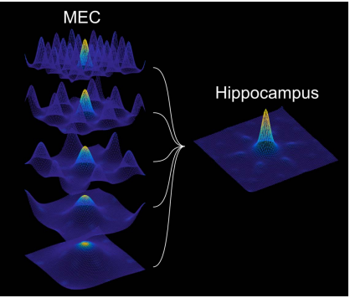
Transformation of neural codes
Reproduced from Solstad et al. (2006). Hippocampus 16:1026-1031

Slide 9
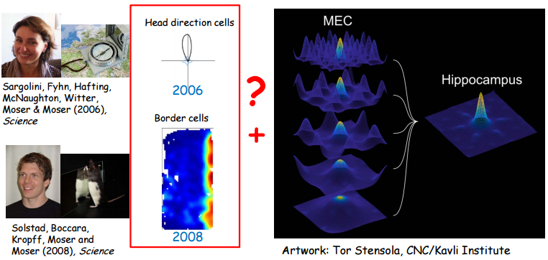
Transformation of neural codes
YES

Slide 10
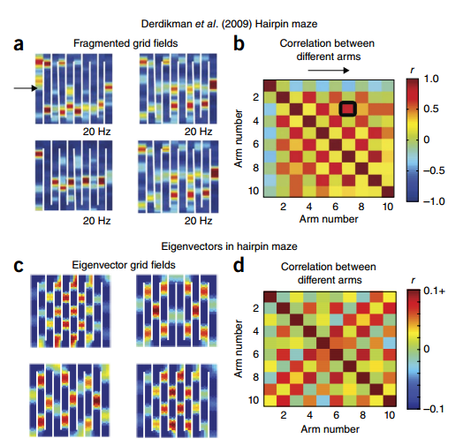
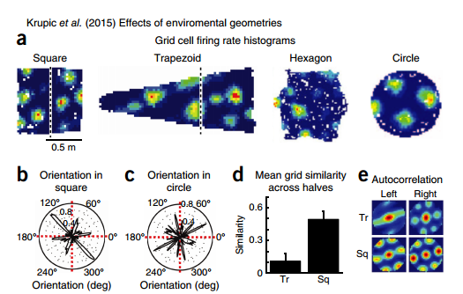
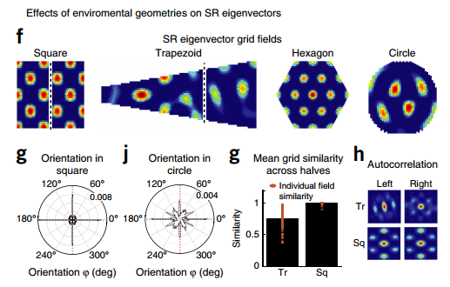
Reproduced from Kimberly L Stachenfeld et al. (2017) Nature Neuroscience.

Slide 11

View: the function of Hippocampus
The hippocampus as a cognitive map
The hippocampus as a predictive map

Slide 12
Reinforcement Learning (RL) model
Simulating the function of Hippocampus

Slide 13

The successor representation
Reproduced from Internet

Slide 14
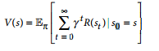
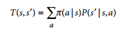
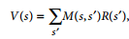
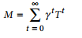
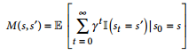
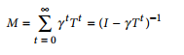
The successor representation
V(s):value functions in spatial RL
S: current state, S': future state, gamma: discount factor[0,1]

Slide 15
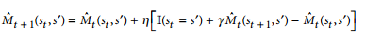
M(s,s`) = 1 if s = s`, and M(s,s`) = 0 if s ≠s`

Slide 16
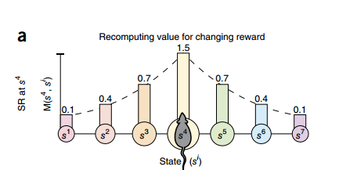
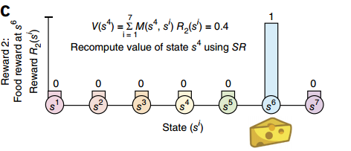
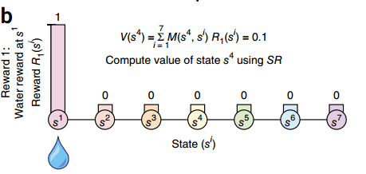
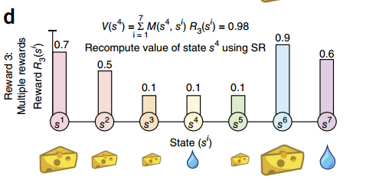

Slide 17
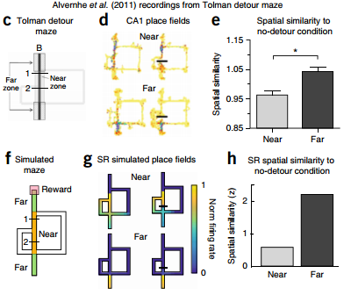
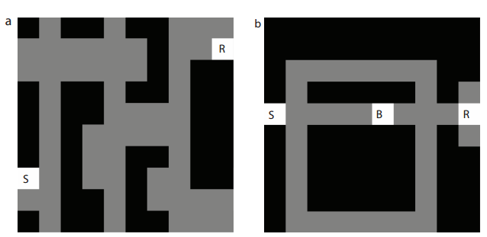
Grid-world representation of Tolman’s tasks.
Reproduced from EM.(2016). bioRxiv.doi: http://dx.doi.org/10.1101/083857

Slide 18
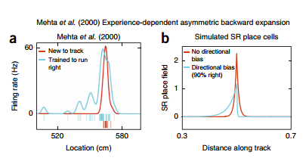
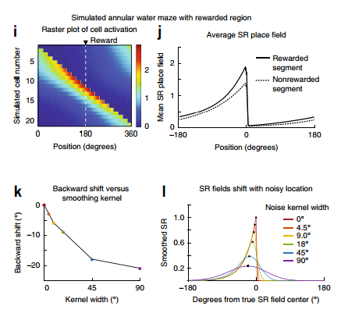
Reproduced from Kimberly L Stachenfeld et al. (2017) Nature Neuroscience.

Slide 19
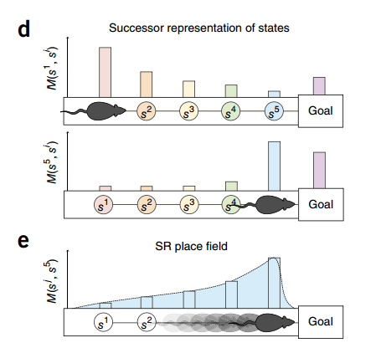
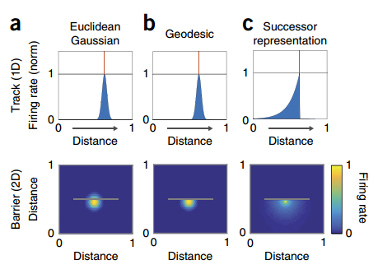

Slide 20
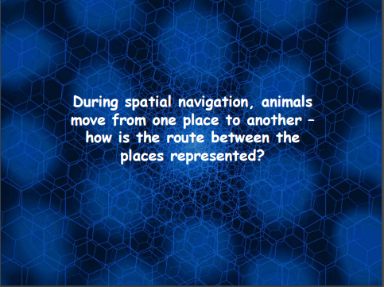


Slide 21
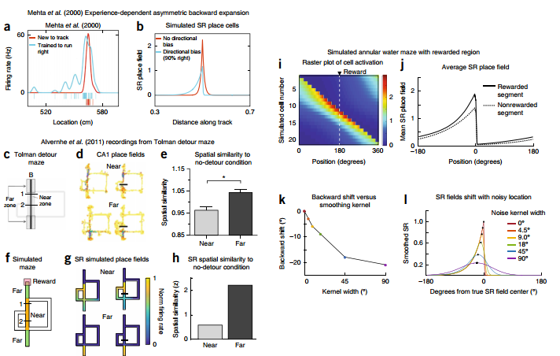
Reproduced from Kimberly L Stachenfeld et al.(2017). Nature Neuroscience

Slide 22
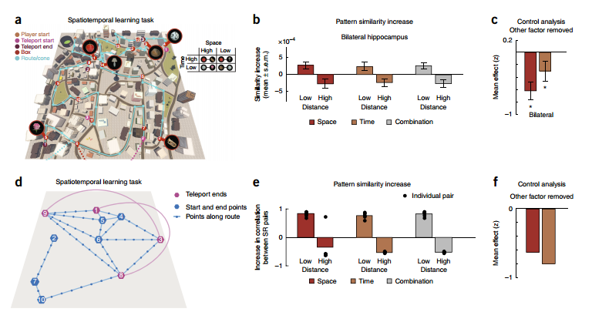
Conclusion: we argue that entorhinal grid cells encode a low-dimensionality basis set for the predictive
representation, useful for suppressing noise in predictions and extracting multiscale structure for hierarchical planning.

Slide 23
Neuroscience and Deep learning (AI)

Slide 24
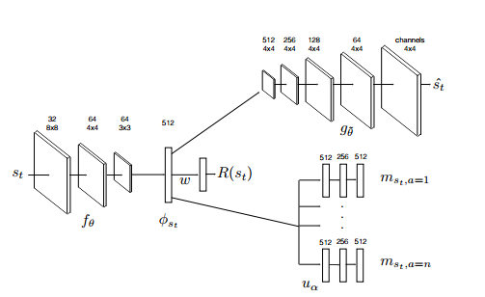

Deep Successor Reinforcement Learning
Model Architecture
Reproduced from arXiv.org:1606.02396

Slide 25
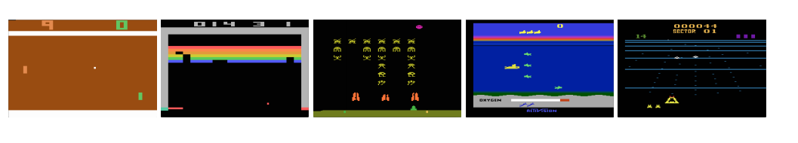
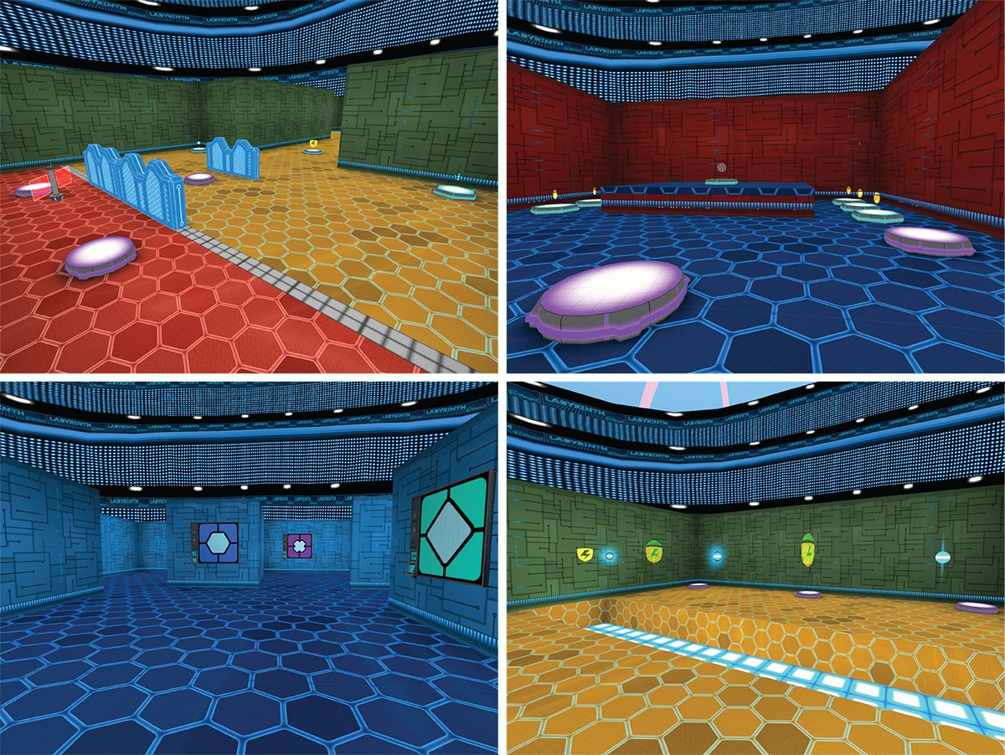

Playing Atari with Deep Reinforcement Learning

